Slide 1

Data Model Approach
Tenacious​

Slide 2

A1 Chips
Tenacious ​
E
A
R
Entity
Attributes
Relationship
Features
Register
Login
View products
Cart
Order
Payment

Slide 3
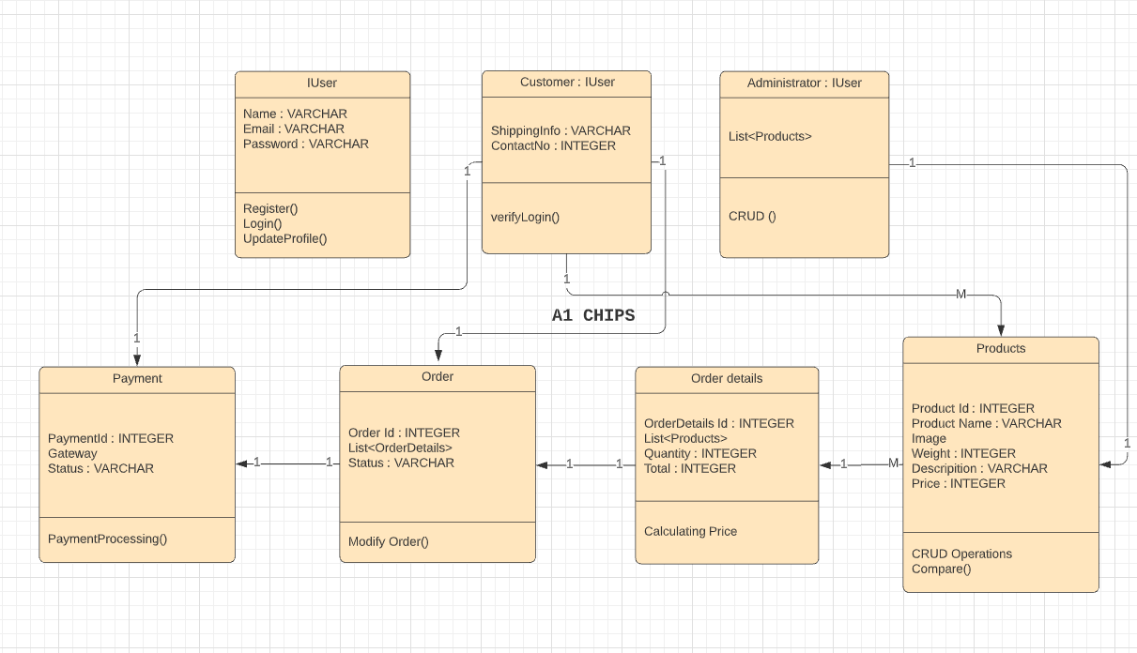
Data Model
Tenacious ​

Slide 4


